Slide 1
Money Blow
(Get your deserved money)
ID 00010443
ID 00010443

Slide 2

Game Details:
Publisher: Lion Studio Downloads: 50 000 000 + Rating: 4,3 Genre: Action Ad Types in Game: In-game ads for boosters
Best likable features in the game: 1. Relieves stress 2. Change of enemies 3. Camera movement game during attackers
Slap Kings

Slide 3

Game Details:
Publisher: Quick Turtle Co. Ltd. Downloads: 500 000 + Rating: 4,4 Genre: Role Playing Ad Types in Game: Offers in-app purchases
Best features you like in the game: 1. Super entertaining extra functions 2. Bright colors that are not disgusting to the eye, but rather differently creates a more dynamic atmosphere 3. It's also cool that there are self-dismissal questions that sometimes help
Don't get fired!

Slide 4
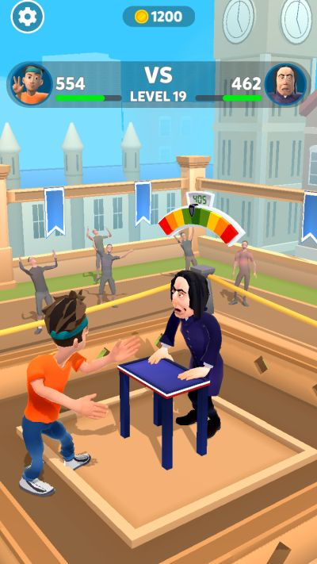
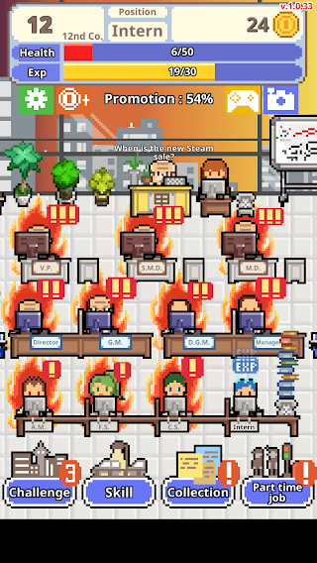
Slap Kings Don't get fired!
Merge Ideas and Settings of these 2 games.
I take feature of face slapping from Slap Kings and feature of office game from Don't get fired!
I use Setting of Don't get fired! with office tables and similar Character of Slaps Kings

Slide 5
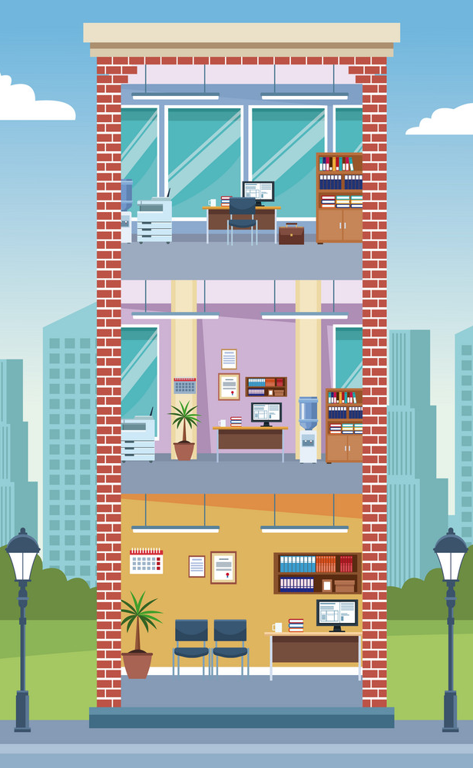
My Game
The hero of the game is the director of the company. The player should help her to build a branch of her company.
To do this, she attracts investors to her company and shows productivity in the work department. She presents company to investors as having strict governance.
If investors see at least one sleeping worker in the office, they will immediately refuse to offer an investment for a company branch.

Slide 6
The player's task is to wake up sleeping workers by slapping them in the face before the investor approaches the table of these sleeping workers. In the game, before a worker falls asleep, a red light above the worker's head will turn on for a few seconds.
The red light does not affect exposure from investors. Only the process of workers' sleep itself affects. The red light appears only to help the player react faster.
Player should also show diligence to investors. Therefore, the player needs to collect a certain number of documents (points) from the workers, until these documents disappear in five seconds.
A total of nine workers. Three investors. And one player.

Slide 7
The game ends if:
investors will see at least one sleeping worker
the player does not collect the required number of points (documents)
if player slap a sleeping worker
Level 1. Collect 20 points = 20 documents. Each worker makes 3 documents (a total of 27 documents in the first round). This is enough to collect 20 documents. The main thing is not to forget that the documents disappear in 5 seconds. Extra collected points go to the second round. The player's responsiveness is assisted by a red light that illuminates above the sleepy worker's head. The main thing is hurrying up to slap the worker in the face before investors notice them, and not to touch the awake workers.

Slide 8
Level 2. Collect 30 points (documents). Each worker makes already 4 documents (a total of 36 documents in the second round). The documents disappear after 4 seconds. This is enough to collect 30 documents. Round 1 rules are repeated.
Level 3. Collect 40 points (documents). Each worker issues already 5 documents (a total of 45 documents in the second round). This is enough to collect 40 documents. The documents disappear after 3 seconds.
☆ If in the previous levels the player did not miss a single Robber, then bonuses are awarded in the next round.
☆ If Player win each round, each floor of the character's company branch will be completed.

Slide 9
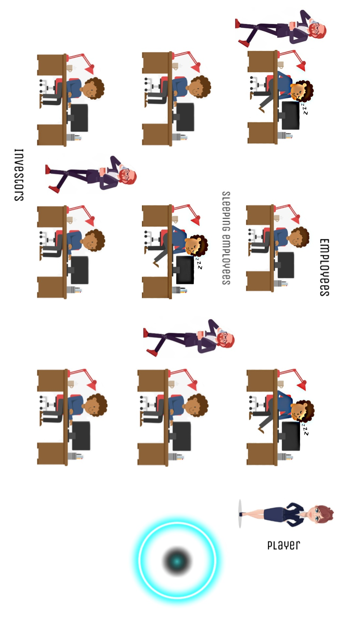
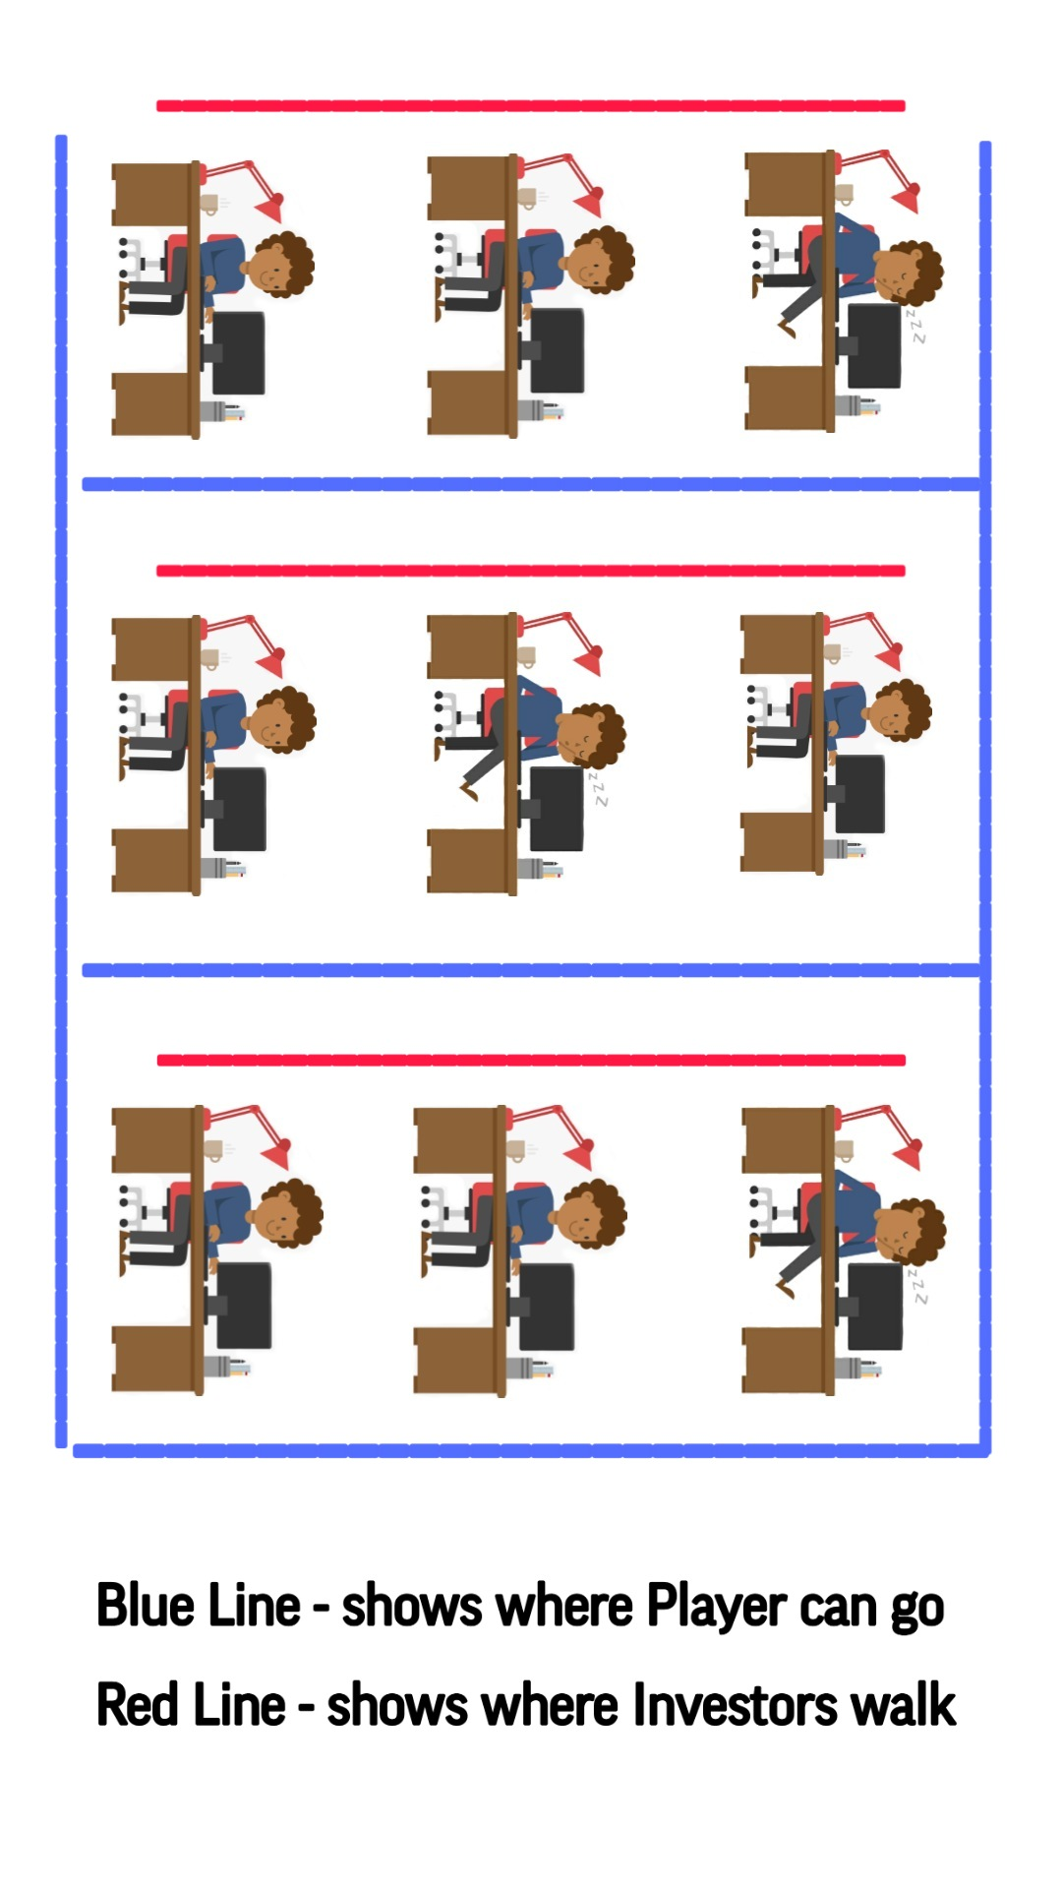
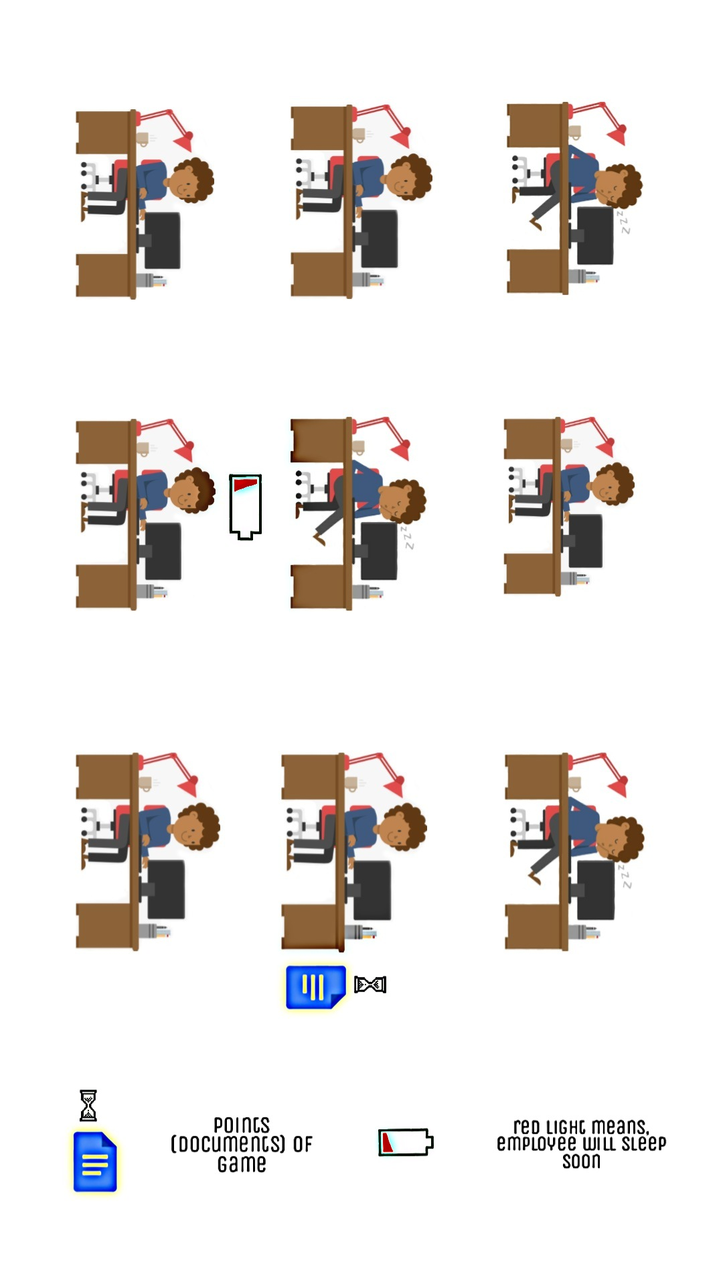
Look of the Money Blow

Slide 10
Look of the Money Blow

Slide 11
Mechanics of the Game
Input
Tap – to start the game Scroll - to move Swipe – to play the game (slap)
Player controls – Slapping, collecting points
Game has – Company Owner (player), Members (Employee), Obstacles (Investors)
Game is challenging because player uses dexterity and reflection feelings. It is hard to control yourself when you need to be hurry to slap. The player needs to hurry to collect points

Slide 12
What is so unique about my Game?
It’s a rare moment when players can play easy games about business with investors
Face punch weapon is not used in running games
The goal of building new company is super satisfying

Slide 13
CPI. Retention.
This game develops well the reflex abilities of thinking and fingers
After completing each round, an unfinished look of the company will appear. The player will have the urge to play over and over again to see the finished version of the company
For people who find doing business difficult and boring, this game can prove otherwise. It is a rather fun and risky activity that can lead to productive consequences

Slide 14
Monetization
Rewarded Ads:
Partner for one playing. He will help the player to avoid conflicts (caught sleeping employees) with Investors. - $2,00
Assistant for one playing. He will help the player to collect points. - $1,00
In-app purchases:
Remove Ads - $2.99

Slide 15
Project Timeline
What and when you plan to do
https://www.notion.so/dd5f865995224b4685c5e9a8d2cc2ad8?v=3121e0e65983441086fb1f1aae373642

Slide 16
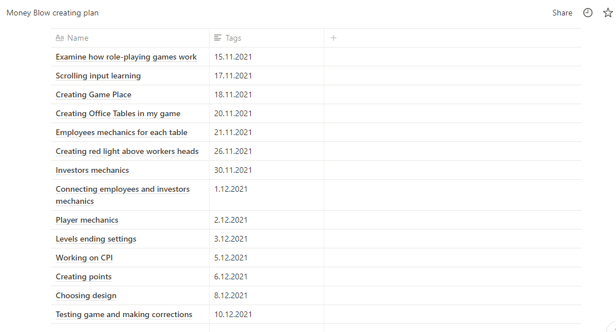
Project Timeline

